Slide 1
MAW01 – Application Cloud Migrations: Lessons Learned from the Field
Wednesday, Dec. 5th

Slide 2
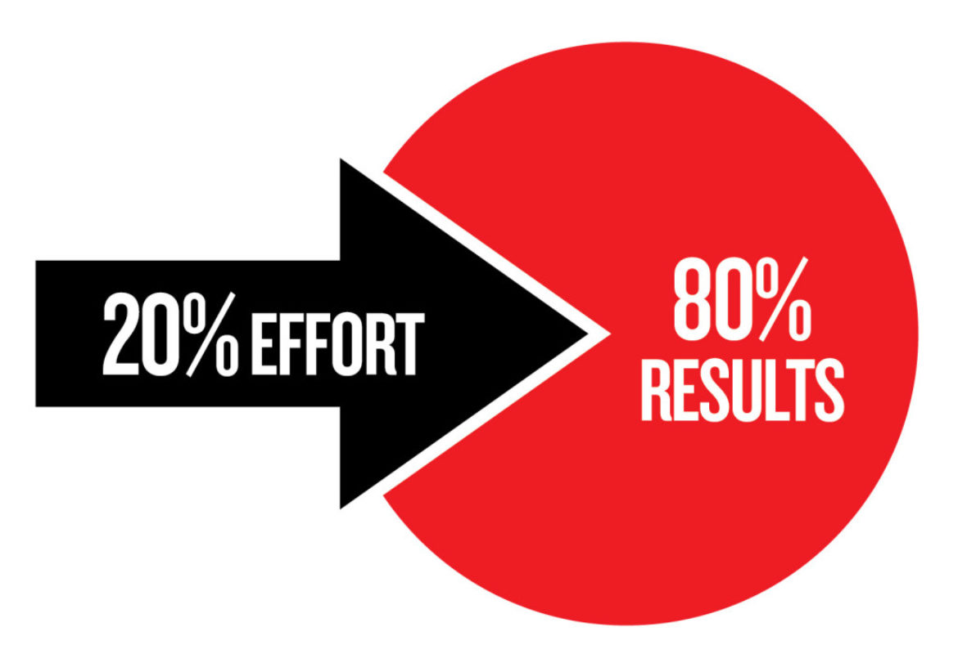
It's harder than you think
"Easy Peasy Lemon Squeezy" - Francesca Beauman, How to Crack an Egg with One Hand: A Pocketbook for the New Mother (2013)

Slide 3
It will take longer and cost more.
It just will.

Slide 4
1
M
2
3
Time
<> | Name | Purpose | Exit Criteria
1 | 1/3 | Fast 5 | Runs on PCF, Jenkins Built and Deployed, on CL GitHub
M | 1/2 | Do we have enough time to get to 3? | We adjust timeline or not
2 | 2/3 | Tech Debt, Refactoring, Stabilization | 3/3 starts (Timebox)
3 | 3/3 | Production Readiness, Like for Like testing, Runbook, handover, etc. | Runs in production Managed by Maint. Team

Slide 5
Ask is the 80% we get by doing to 20% enough, yes, snowflakes are bad, but is fixing them worth the pain and extra effort?

Slide 6

Migrating to where? Think 3 times
三思而行 – Chinese Proverb

Slide 7
What is the best new host that supports the development platform you use now?
PaaS and Containers can help!

Slide 8
Adopt something where you have lots of company. Being an early adopter may be more excitement than your organization can stand

Slide 9
Make a pro/con list for each alternative
ROI?
Time?
Agility?
Stability?
Growth?
Risk!
Familiarity?
Fitness for purpose?
Future Fit?
Compliance?
Financial model?

Slide 10
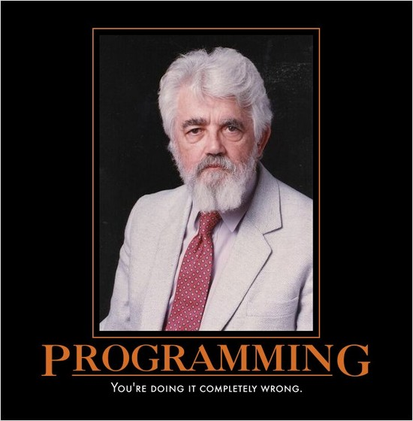
It's the code (sometimes)
There's nothing wrong with my code that getting rid of the users would not fix… -Anon

Slide 11
The 12Factor.net factors
I. Codebase
One codebase tracked in revision control, many deploys
II. Dependencies
Explicitly declare and isolate dependencies
III. Config
Store config in the environment
IV. Backing services
Treat backing services as attached resources
V. Build, release, run
Strictly separate build and run stages
VI. Processes
Execute the app as one or more stateless processes
VII. Port binding
Export services via port binding
VIII. Concurrency
Scale out via the process model
IX. Disposability
Maximize robustness with fast startup and graceful shutdown
X. Dev/prod parity
Keep development, staging, and production as similar as possible
XI. Logs
Treat logs as event streams
XII. Admin processes
Run admin/management tasks as one-off processes

Slide 12
Before you Migrate
Do the 12-Factor "Fast Five"
Find and close memory leaks
Clean up your code
Linters, BPAs, Security Tools
Upgrade your runtime and libraries to be the same and modern
Perf + Acceptance Tests, have some!

Slide 13
Beware
The GAC
The Registry
The Local File-System
Pre-Installed Components
COM(+), DTC, Native Calls
Deployment order dependency

Slide 14
InfoSec hates you, and probably for a good reason…

Slide 15
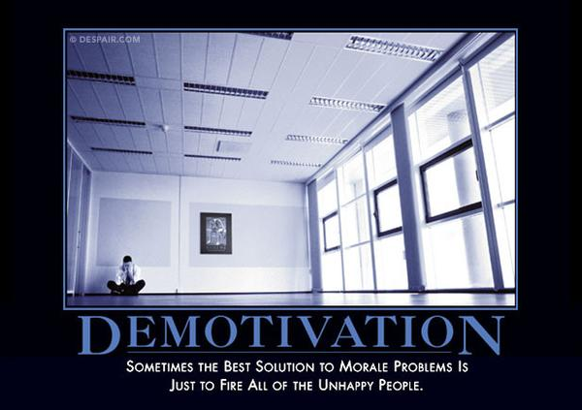
It's the people (always)

Slide 16
Migrations are duration not effort based…. Why?
Milestones are based on achievement not time!
Plus that whole people thing…

Slide 17
Not everyone wants to or can change… So…

Slide 18

Tips for smoothing the road
That was smooooooth – Invader Zim

Slide 19
Do the scary stuff first.

Slide 20
Talk w. Networking, DevOps, and Security, early and often.
Otherwise you may discover "Requirements" and "Challenges"

Slide 21
Infrastructure is evolutionary and takes multiple iterations.
Plan for that… and AUTOMATE

Slide 22
Get something running in the new environment early, and deploy constantly!

Slide 23
Plan and Rehearse your migrations, especially the data and file moves.
It is way harder than you think.

Slide 24
No automation?
Not done.

Slide 25

Last thoughts
I was thinking about it, and now not so much – me, myself, and I

Slide 26


Slide 27


Stuart Williams
Cloud/DevOps Practice Lead + National Markets Consultant
Magenic Technologies Inc.
Email: stuartw@magenic.com
Blog: http://blitzkriegsoftware.net/Blog
LinkedIn: http://lnkd.in/P35kVT
GitHub: https://github.com/BlitzkriegSoftware
YouTube: https://www.youtube.com/channel/UCO88zFRJMTrAZZbYzhvAlMg
Get the code: https://github.com/BlitzkriegSoftware/MAL2018

